Slide 1
Intelligent Acute Brain Hemorrhage Diagnosis System
Project By
Rajesh Rajwade
Vishal Shende
Saurabh Vartak

Slide 2
Agenda
Introduction
Why the Intelligent System
System Overview
Input CT image
Intracranial Extraction
Image Enhancement & ROI Extraction
Morphological Operations
Feature Extraction
Algorithm
Presentation Layer
Conclusion

Slide 3
Introduction
In accident cases most of the patients are admitted to the Hospital under emergency for treatment are immediately sent for CT Scan .
Patients having an injury are susceptible to internal bleeding in the brain which is very dangerous .
Our aim is to develop an automated process which would do the basic diagnosis and detect the type of Hematoma in order for further diagnosis and treatment by the doctor.

Slide 4
Why Intelligent System?
The mortality rate in the first 30 days after the hemorrhage is about 50 percent, which is the highest for any type of stroke.
Basic detection of hemorrhage is a relatively simple process and does not need doctoral expertise.
Thus our Intelligent System will eliminate the step where a doctor analyses the scans and lands on a conclusion.
This will enable him to concentrate on more severe medical problems.

Slide 5
Why CT Scan?
CT is Cheaper
Readily Available
Time Factor
Bone Pathology is good

Slide 6
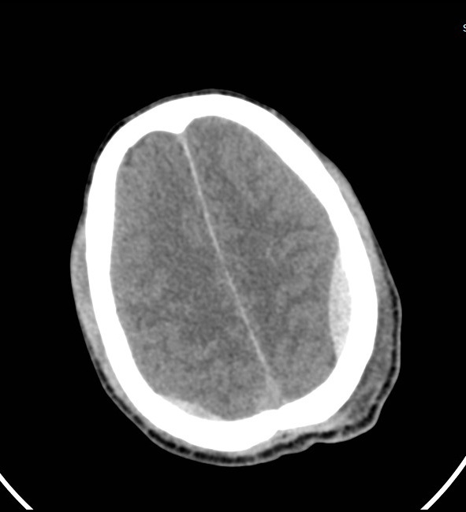
EPIDURAL HEMATOMA
Epidural is a type of traumatic brain injury in which a buildup of blood occurs between the Dura matter.
It forms a Bi-Convex shape.

Slide 7
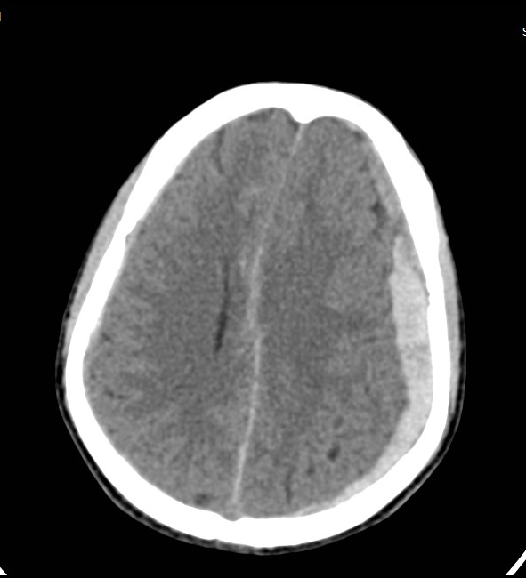
SUBDURAL HEMATOMA
A subdural hematoma (SDH), is a type of hematoma, usually associated with traumatic brain injury.
It forms a Concavo-Convex shape.

Slide 8
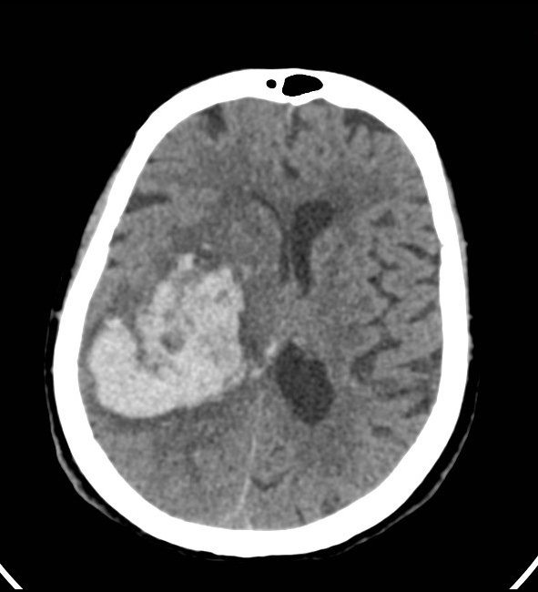
HYPERTENSIVE BLEED
A hypertensive bleed is a type of intracranial hemorrhage that occurs within the brain tissue itself.
Caused by brain trauma.
Doesn’t have any specific shape.

Slide 9
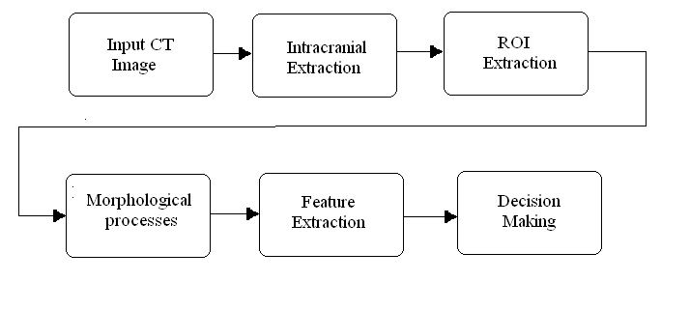
System Overview

Slide 10
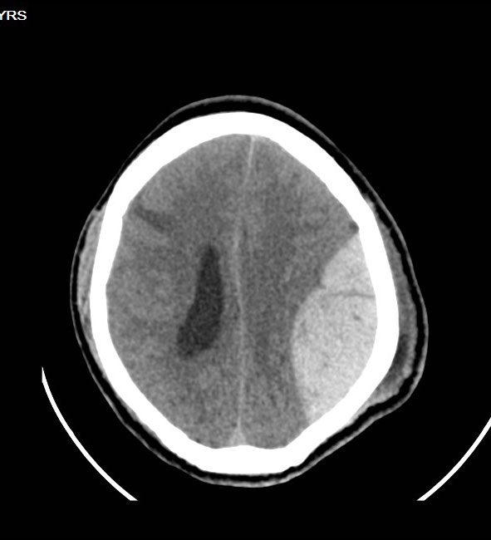
Input CT image
Skull
Brain Tissue
ROI(hemorrhage)

Slide 11

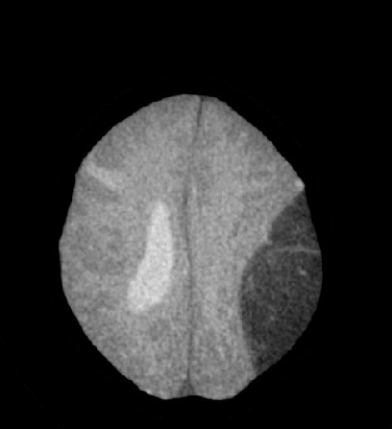
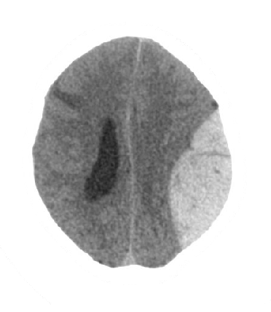
Intracranial Extraction
Input CT Scan image is fed to MATLAB for Intracranial Area Extraction
IMAGE FILL
IMAGE SUBTRACTION
IMAGE NEGATIVE

Slide 12
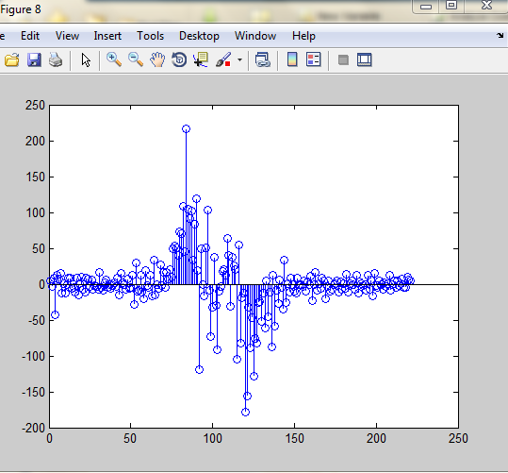
Image Enhancement & ROI Extraction
Histogram based thresholding for bleed extraction
Derivative of the histogram and smoothen it by Wiener filter.

Slide 13
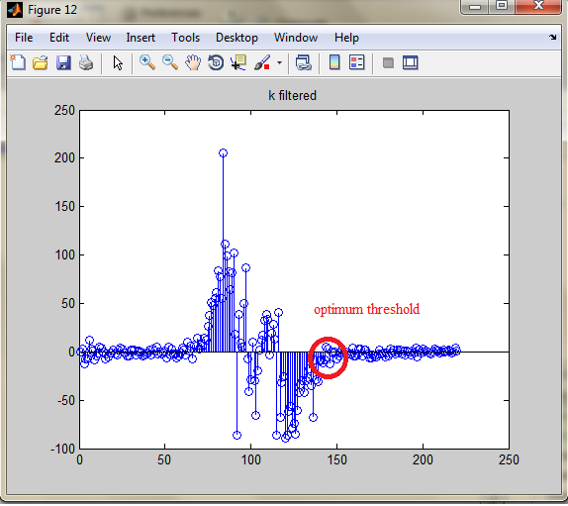
Image Enhancement & ROI Extraction
Locate threshold at the point where the derivate curve intersects the X axis
This is the optimum threshold

Slide 14


Morphological Operations
Global Thresholding produces noisy result and unconnected components.
Hit and Miss Operations are used to eliminate noise.
Dilation is done by kernel aligned to largest connected component in image
Output provided to decision making for distinction

Slide 15
CLASSIFICATION
EDH SDH HTN

Slide 16
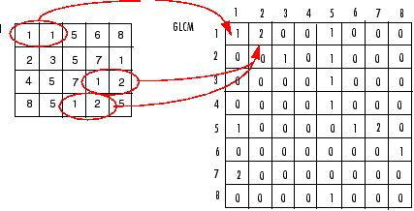
Texture Features
GLCM functions characterize the texture of an image
GLCM function, extract statistical measures(Contrast, Correlation, Energy, Homogeneity) and then a matrix is created

Slide 17
Contrast | Measures the local variations in the gray-level co-occurrence matrix.
Correlation | Measures the joint probability occurrence of the specified pixel pairs.
Energy | Provides the sum of squared elements in the GLCM. Also known as uniformity or the angular second moment.
Homogeneity | Measures the closeness of the distribution of elements in the GLCM to the GLCM diagonal.

Slide 18
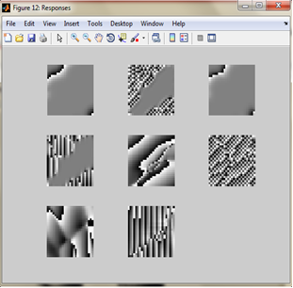
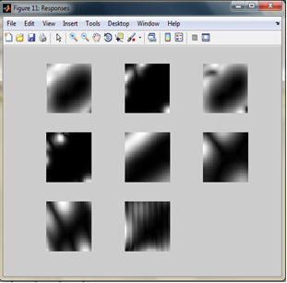
Texture Features
GABOR Filter
STFT used for edge detection
It does simultaneous time and frequency filtering.
Gabor filter bank generates 16 filtered images used for Texture Features

Slide 19
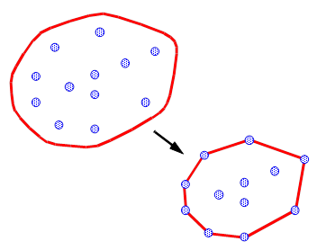
Feature Extraction
Convex Hull
The convex hull of a set of planar points is defined as smallest convex polygon containing all of the points.

Slide 20




Feature Extraction
Solidity
Solidity is ratio of pixels present in convex hull to pixels present in original bleed . This is important feature to discriminate between EDH and SDH

Slide 21
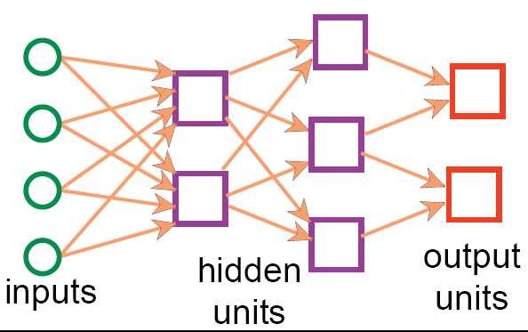
Neural Networks
A Neural Network generally maps a set of inputs to a set of outputs
Number of inputs/outputs is variable
The Network itself is composed of an arbitrary number of nodes with an arbitrary topology

Slide 22
NEURAL NETWORK LEARNING
Aim of Neural Network learning:Given a set of examples,find parameter settings that minimises the error.
Back Propogation learning is gradient decent search through the parameter space to minimize the sum of square errors.

Slide 23
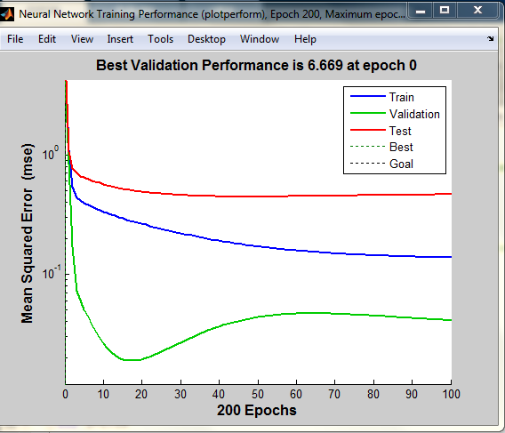
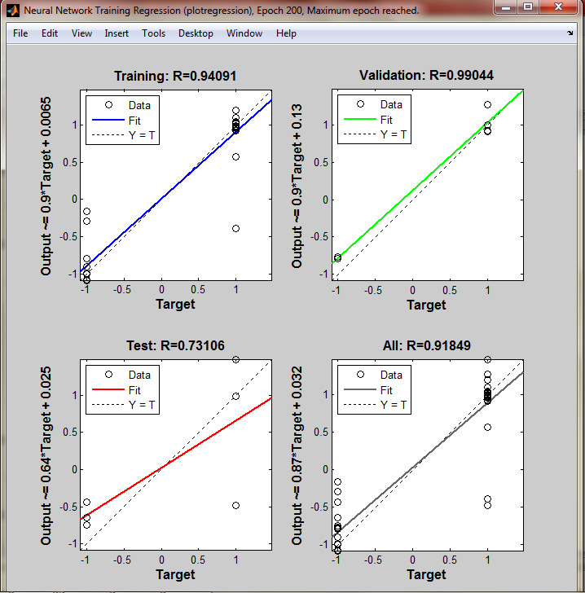
Neural Network application window

Slide 24
Support Vector Machine
Support Vector Machines (SVM's) are a relatively new learning method used for binary classification.
Finds a hyper plane which separates the d-dimensional data perfectly into its two classes.

Slide 25
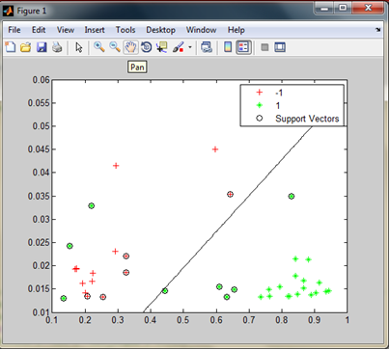
Support Vector Machine

Slide 26
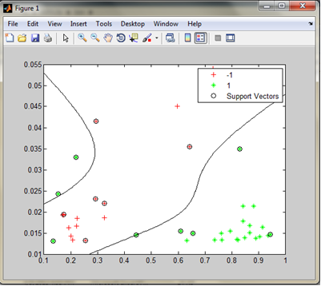
Support Vector Machine

Slide 27
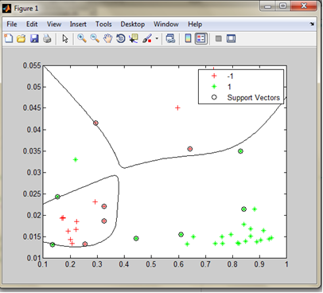
Support Vector Machine

Slide 28
RESULTS
CLASSIFIER | RECALL | PRECISION | ACCURACY
SVM(LINEAR) | 0.875 | 0.913 | 0.88
SVM(QUAD & HIGHER DEGREE) | 0.9583 | 1 | 0.97
NN(7 HIDDEN NEURONS) | 0.83 | 0.87 | 0.852
NN(15 HIDDEN NEURONS) | 0.875 | 0.952 | 0.882

Slide 29
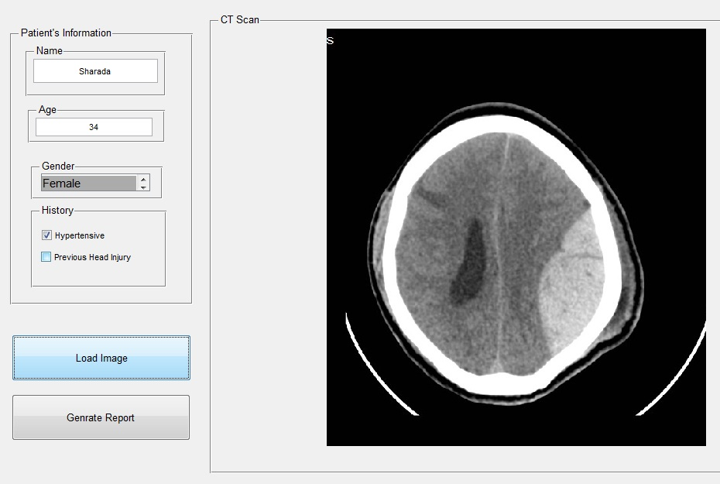
GRAPHICAL USER INTERFACE

Slide 30
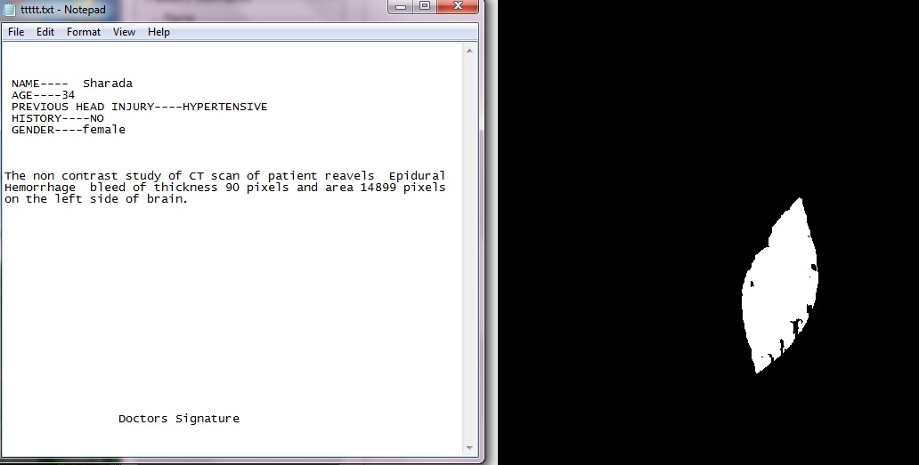
REPORT

Slide 31
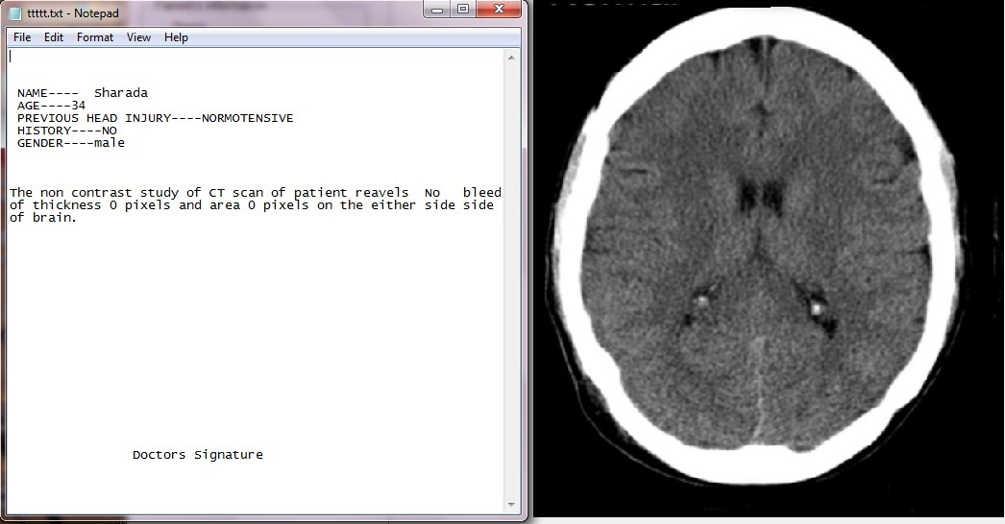

Slide 32
Conclusions
An approach for Brain hemorrhage detection and diagnosis is proposed in this project.
The encouraging results have been attained.
Plans for future work include using deformable templates to extract shape of hemorrhage. Plans also include creating large dataset for training neural network.

Slide 33
Refrences
Intracranial Hemorrhage Annotation for CT Brain Images
Tong Hau Lee, Mohammad Faizal Ahmad Fauzi *, Su-Cheng
Predicting Mortality in Spontaneous Intracerebral Hemorrhage, Daniel Agustin Godoy, MD; Gustavo Piñero, MD; Mario Di Napoli
K.H. Hohne and W.A. Hanson, Interactive 3D segmentation of MRIand CT volumes using morphological operations, J. Comp. Assist.Tomogr. 2, 1992, pp. 285-294.

Slide 34
Qingmao Hu, GuoyuQian, Aamer Aziz, Wieslaw L. Nowinsk,
Segmentation of brain from computed tomography head images,
Proceedings of IEEE Engineering in Medicine and Biology 27th
Annual conference, Sept. 2005, pp. 3375 – 3378.
[5] N. A. Mohamed, M. N. Ahmed, and A. Farag, Modified Fuzzy CMeanin Medical Image Segmentation, Acoustics, Speech, and Signal
Proceedings, vol.6 ,1999, pp. 3429-3432.

Slide 35
Wen-Nung Lie, Wen-Hung Peng, Cheng-Hung Chuang, Efficientcontent-based CT brain image retrieval by using region shapefeatures, ISCAS (4), 2002, pp. 157-160.
Ch.5:SupportVectorMachines Stephen Marsland, Machine Learning: An Algorithmic Perspective. CRC 2009A
Based on slides by Pierre Dönnes and Ron Meir ,Modified by Longin Jan Latecki, Temple University
Convex Hull : Presented By Erion Lin

Slide 36
THANK YOU!

Slide 37
ANY QUESTIONS??

